Slide 1
CSE4227 Digital Image Processing
_{Introductory Class}
Dr. Kazi A Kalpoma
Professor, Department of CSE
& Director of ICT
Ahsanullah University of Science & Technology (AUST)
Contact: kalpoma@aust.edu
Google Class code: cykjms3

Slide 2
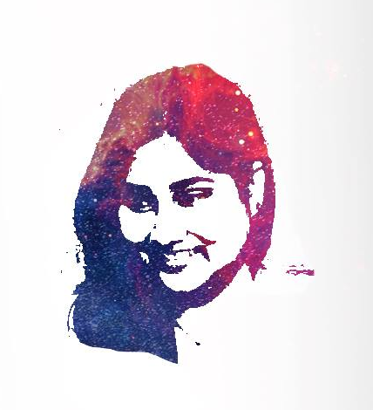
WELCOME TO
MY CLASS
kalpoma@aust.edu

Slide 3
Course Teacher’s Details
B.Sc.: Applied Physics, Electronics and Communication Engineering, Dhaka University. 1994
M.Sc.: Computer Science and Engineering,
^{Dhaka University. 1996}
M.Sc.: Information Sciences, Dept. of Computer and Mathematical Sciences, Tohoku University, Japan. 1998-2000
^{PhD.:} Information Sciences, Dept. of Computer and Mathematical Sciences, Tohoku University, Japan 2004-2007.
^{Post} Doctoral as a Research Fellow at Tohoku University, Japan 2009~2012.

Slide 4
Continuation….
^{Lecturer /} Assistant / Associate / Professor
^{at AIUB, May 2001 ~ Sept 2017}
Visiting Professor at Tohoku University, April-June 2017
^{Professor at AUST, Nov} ^{2017 ~ date}
Director of ICT, AUST May 2019 ~ date
^{IEEE Senior Member}
Reviewer, IEEE(more than a decade.), TCM, PCM of different International Conferences
^{My Profile}

Slide 5
The list of courses I taught:
Digital Image Processing (M.Sc./B.Sc.)
Computer Vision and Pattern Recognition (M.Sc.)
Machine Learning and Neural Network (M.Sc.)
Computer Organization and Architecture (M.Sc./B.Sc.)
Advanced Operating System (M.Sc.)
Operating System
Programming Language (C/C++ )
Discrete Mathematics
Data Structure
Research Methodology

Slide 6
My Research Area:
Image processing
Satellite Image Processing and Its Applications
Computer Vision and Pattern Recognition
Human Computer Interaction
Artificial Intelligence and Machine Learning
Cyber Security

Slide 7
Contact Information
Office: 6th floor, Building-A Room#7A01/D
: 8th floor, Building-D Room: ICT Derector
Email:
kalpoma@aust.edu
Tel: 8870422 Ext: 504/350
Facebook: kalpoma@yahoo.com
Linkedin: kalpoma@yahoo.com
Research gate: kalpoma@yahoo.com
Please send me message before sending any friend request in social media

Slide 8
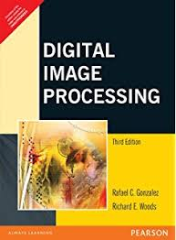
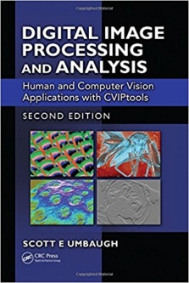
Reading Materials
^{Textbook}
R.C. Gonzalez and R.E. Woods, Digital Image Processing (3rd Edition), Prentice Hall, 2008
Scott E Umbaugh, Digital Image Processing and Analysis: Human and Computer Vision Applications with CVIPtools, Second Edition

Slide 9
Reading Materials
R.C. Gonzalez, R.E. Woods, and S.L. Eddins, Digital Image Processing Using MATLAB (2nd Edition), 2009
M. Sonka, V. Hlavac, and R. Boyle, Image Processing, Analysis, and Machine Vision, Thomson, 2008
“Fundamental of Digital Image Processing”, Anil K. Jain.
Anil K. Jain, , Fundamentals of Digital Image Processing', Pearson 2002.
Kenneth R. Castleman, Digital Image Processing, Pearson, 2006.
D,E. Dudgeon and RM. Mersereau, , Multidimensional Digital Signal Processing',Prentice Hall Professional Technical Reference, 1990.
^{My Slides}
https://www.tutorialspoint.com/dip/index.htm

Slide 10
Marks Distribution:
Attendance and Class Performance | 10
Class Test | 20
Final Exam | 70
Total | 100
Four class tests will be taken and best THREE will be considered for “Class Test” marks.

Slide 11
PRE-REQUEST:
  Students will be expected to be familiar with
  Data Structure
  Basic Probability/Statistics
  Linear Algebra
  Vector Calculus

Slide 12
Course Contents
Digital Image Fundamentals (Chap-1&2)
    Digital image processing (DIP)
    Key stages of DIP
    Digital image Representation
Image Sensing and Acquisition (Chap-2)
    Human Perception, Image Formation, Image Acquisition
    Image Digitization (sampling and quantization)
    Pixels & their relationships
  Intensity Transformations and Spatial Filtering (Chap-3&4)
      Image enhancement in spatial domain
      Histogram processing
      Image enhancement in frequency domain
  Morphological Image Processing (Chap-9)
    Erosion, Dilation, Opening and Closing, Hit-or-Miss Transformation, Thinning, Thickening, Skeletons.
Image Segmentation (Chap-10)
    Edge/Line detection
    Segmentation
  Image Compression (Chap-8)
      Data Redundancy,
      Image Entropy,
      Different Compression Techniques
  Color Image processing fundamentals (Chap-6)
      Color Fundamentals
      Color Models and Examples
Image Restoration (Chap-5)

